Slide 1
Transfer Learning-Based Classification Of Poultry Diseases For Enhanced
SlideMake.com

Slide 2
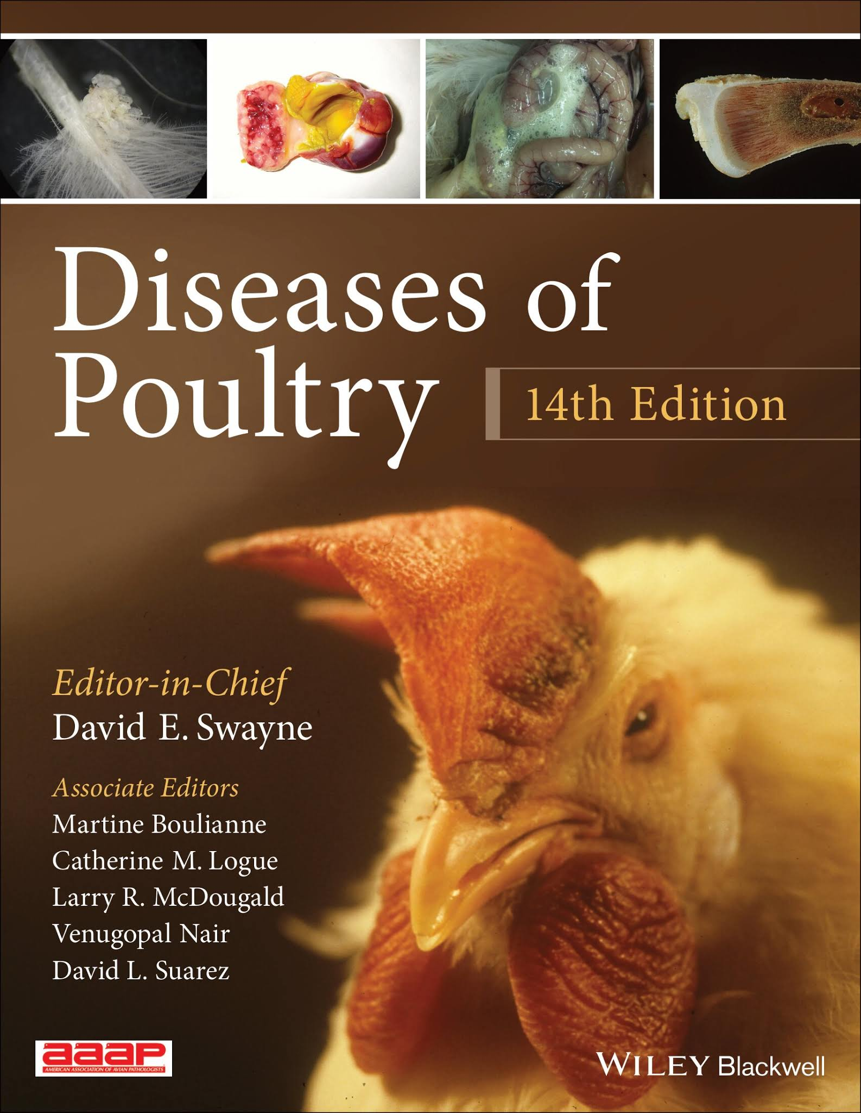
Introduction to Poultry Disease Classification
Poultry diseases significantly impact the global poultry industry, causing economic losses and affecting food security.
Accurate and timely diagnosis is essential for effective disease management and control.
Traditional diagnostic methods can be time-consuming and require expert knowledge, prompting the need for automated solutions.
Notes:
Image source: https://1.bp.blogspot.com

Slide 3
Challenges in Poultry Disease Diagnosis
Visual symptoms of poultry diseases can be similar across different illnesses, complicating diagnosis.
Limited access to veterinary experts in remote areas hampers early detection efforts.
Variability in disease presentation and environmental factors can reduce the accuracy of traditional methods.
Notes:
Image source: https://1.bp.blogspot.com

Slide 4
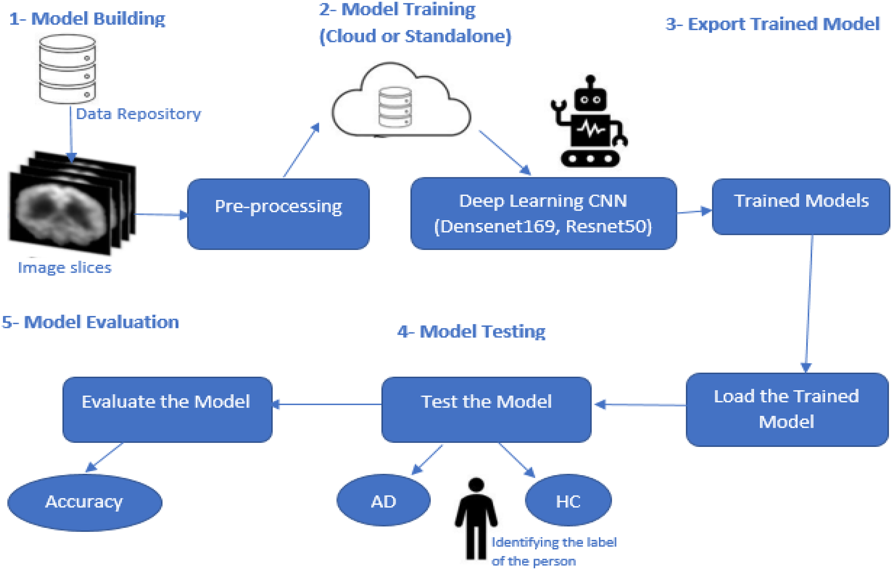
Role of Machine Learning in Disease Classification
Machine learning techniques can automate the detection and classification of poultry diseases from images.
They offer rapid, scalable, and cost-effective solutions for large-scale poultry health monitoring.
However, training high-performance models requires large labeled datasets, which are often scarce.
Notes:
Image source: https://dfzljdn9uc3pi.cloudfront.net

Slide 5
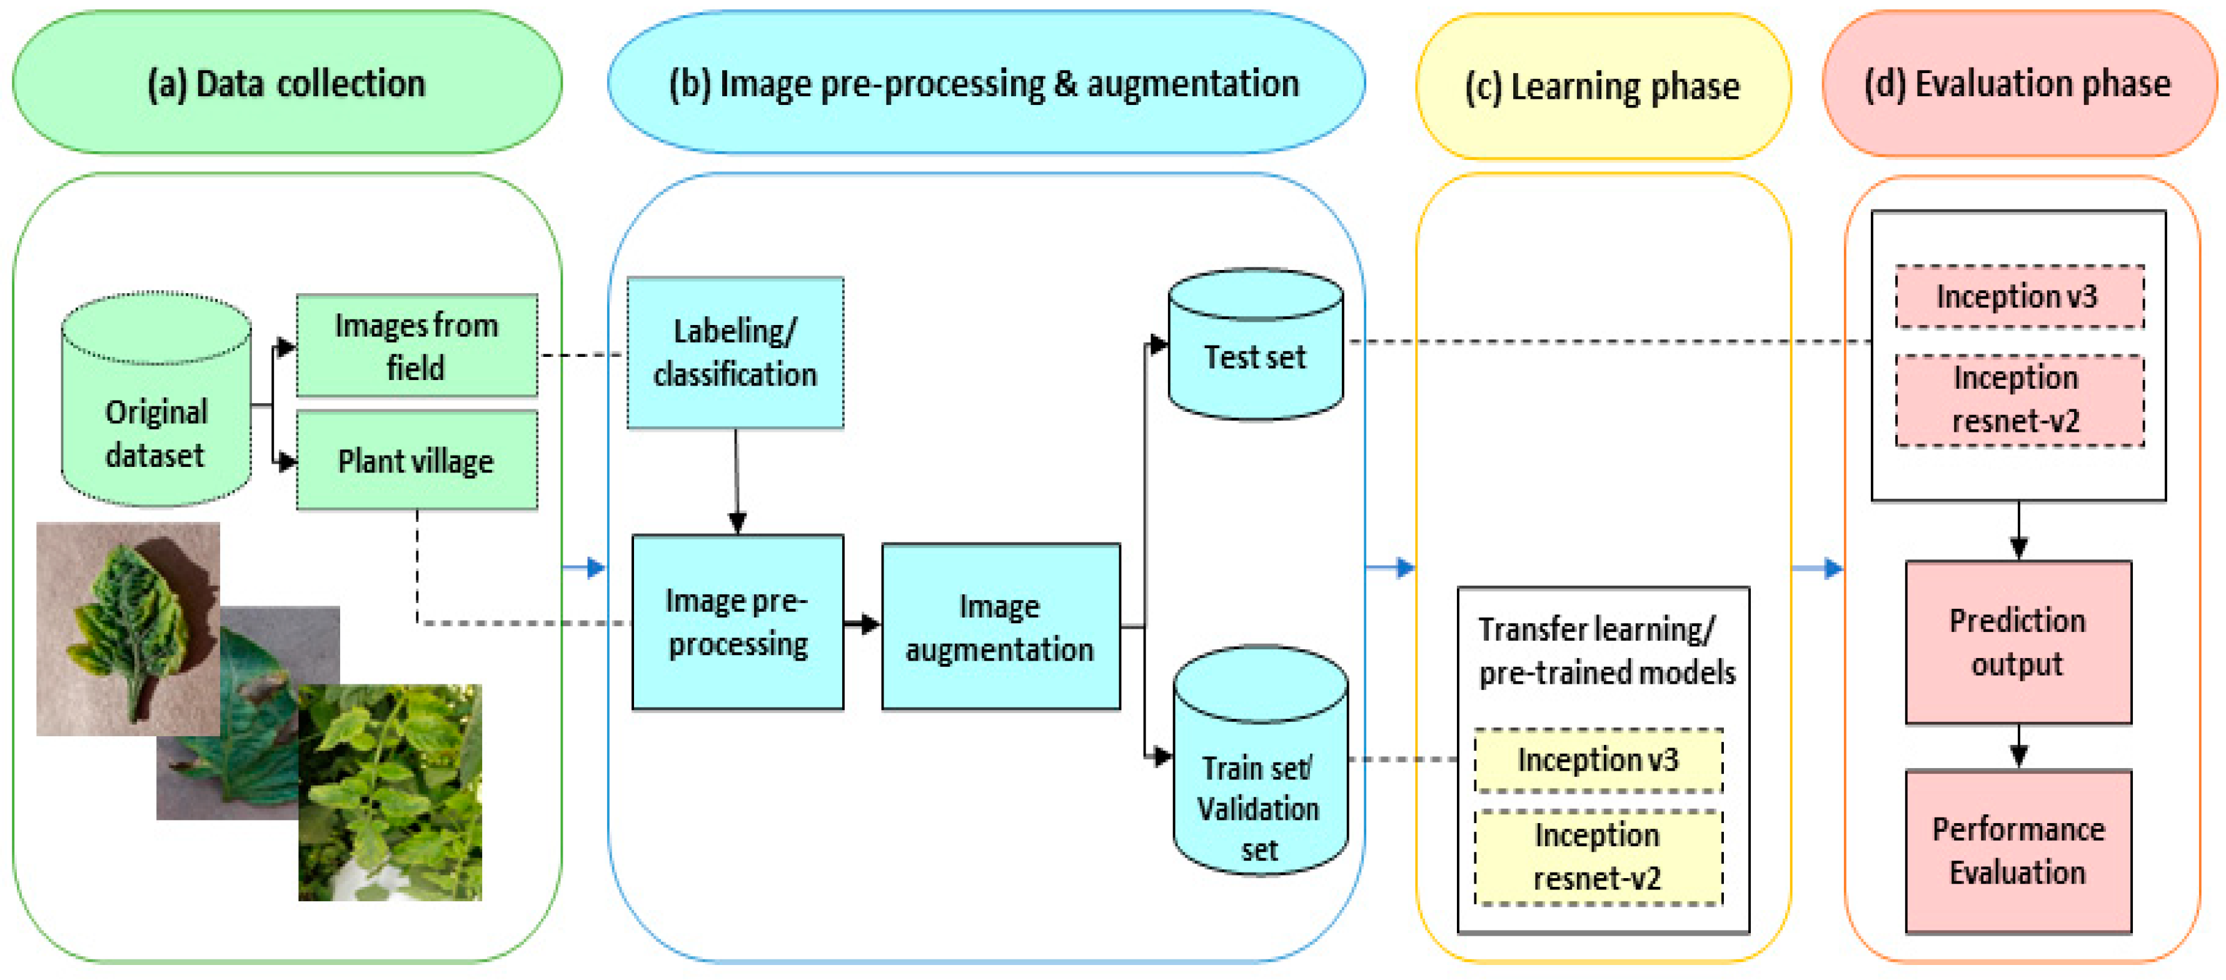
Introduction to Transfer Learning
Transfer learning leverages pre-trained models on large datasets to solve specific, smaller datasets problems.
It helps overcome data scarcity by transferring learned features from general image datasets to poultry disease images.
This approach reduces training time and computational resources while maintaining high accuracy.
Notes:
Image source: https://www.mdpi.com

Slide 6
Methodology Overview
The study uses convolutional neural networks (CNNs) pre-trained on large image datasets like ImageNet.
Fine-tuning involves retraining the last layers of the CNN on poultry disease images for specific classification.
Data augmentation techniques are applied to enhance model generalization and robustness.
Notes:
Image source: https://www.researchgate.net

Slide 7
Dataset and Preprocessing
The dataset comprises images of healthy and diseased poultry, categorized into various disease classes.
Images are resized, normalized, and augmented to improve model learning and reduce overfitting.
Labeling accuracy and balanced class distribution are critical for effective model training.
Notes:
Image source: https://www.mdpi.com

Slide 8
Model Training and Evaluation
Different pre-trained models such as VGG16, ResNet50, and InceptionV3 are evaluated for performance.
Metrics like accuracy, precision, recall, and F1-score are used to assess classification effectiveness.
Cross-validation techniques ensure the robustness and reliability of the model results.
Notes:
Image source: https://www.researchgate.net

Slide 9
Results and Findings
Transfer learning models achieved high accuracy, often exceeding 90% in disease classification tasks.
ResNet50 demonstrated superior performance due to its deep architecture and residual learning capabilities.
The approach significantly outperformed traditional machine learning methods trained from scratch.
Notes:
Image source: https://www.researchgate.net

Slide 10
Implications and Future Directions
This transfer learning approach can be integrated into poultry health management systems for real-time monitoring.
Future work includes expanding datasets, incorporating multispectral imaging, and deploying mobile applications.
Continuous model updates and validation are essential for maintaining accuracy across different environments.
Notes:
Image source: https://www.researchgate.net

Slide 11
References
[Insert relevant references here, such as journal articles, conference papers, and datasets used in the study.]
Your second bullet
Your third bullet

